Slide 1

Capstone Project
Credit Card Default Prediction
Team Members
Ankit Patel
Sushmita Chaudhary
Vishwas Chole

Slide 2
CONTENTS
Introduction
Problem Statement
Methodology
Loading the data
Exploratory Data Analysis
Treating missing values and outliers
Feature engineering
Train test split
Data Modeling
Model interpretation
Train and test interpretation
Conclusion

Slide 3
INTRODUCTION
Due to COVID-19, many people have lost their jobs, resulting in people strapping for cash and defaulting on their credit card payments. Things have gotten so bad that credit card companies, such as JP Morgan and Citigroup have to set aside an additional reserve to cover their losses from credit card defaults. Now, this is a very extreme case, which does not happen often (I really hope not). People’s inability to pay for their credit card bills could be due to different circumstances. However, when it’s deliberate, meaning that customers have no plans in paying the bank back, it would be considered as a fraud. Either way, this imposes a huge risk on the credit card companies and we need to find a way to flag them.

Slide 4
PROBLEM STATEMENT
This project is aimed at predicting the case of customers default payments in Taiwan. From the perspective of risk management, the result of predictive accuracy of the estimated probability of default will be more valuable than the binary result of classification - credible or not credible clients. We can use the K-S chart to evaluate which customers will default on their credit card payments.
the best option to their clients across available options. They have been in operation for a little less than a year now. During this period, they have captured surge pricing types from the service providers.
The main objective is to build a predictive model, which could help them in predicting the surge pricing type proactively. This would in turn help them in matching the right cabs with the right customers quickly and efficiently.

Slide 5
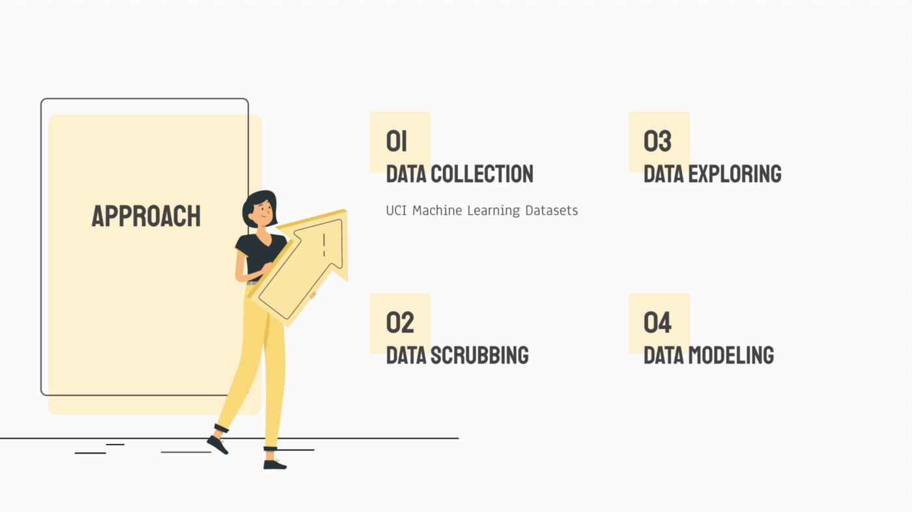
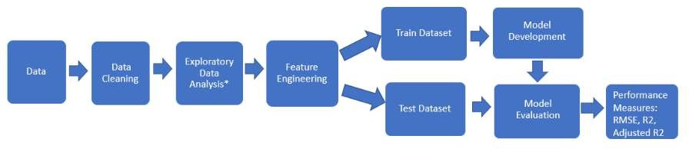
METHODOLOGY

Slide 6
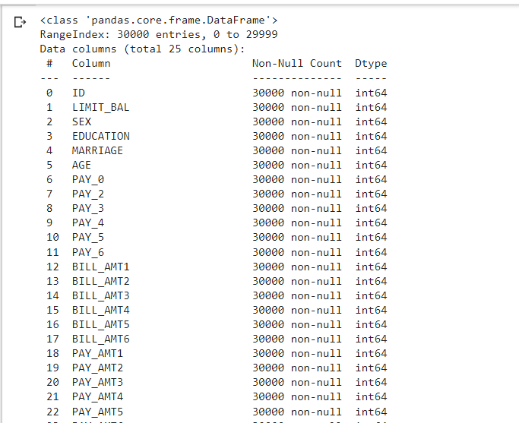
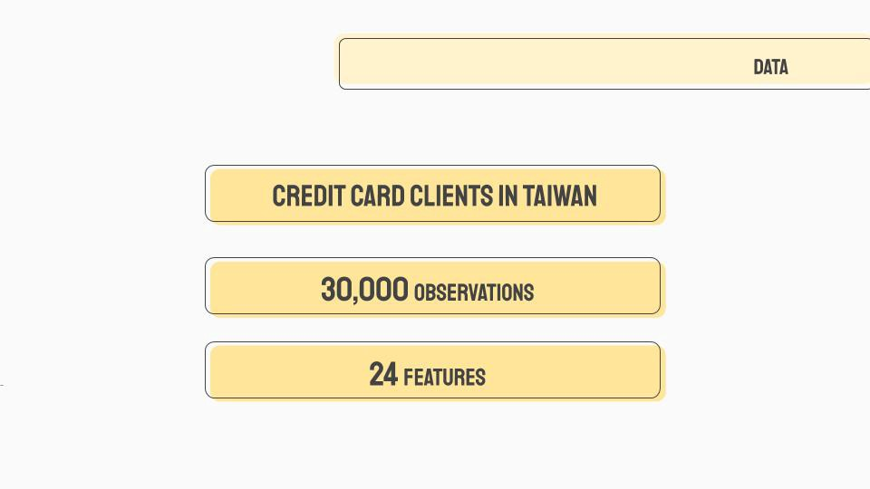
LOADING THE DATA AND DATA CLEANING
After loading the data, we can observe that the data frame contains
30000 rows with 25 variables. And we are trying to have an insight on missing values.

Slide 7
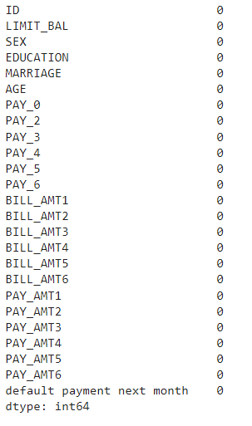
SPREAD OF MISSING VALUES
The data set is pretty clean.
We didn’t found any missing values in the data set

Slide 8
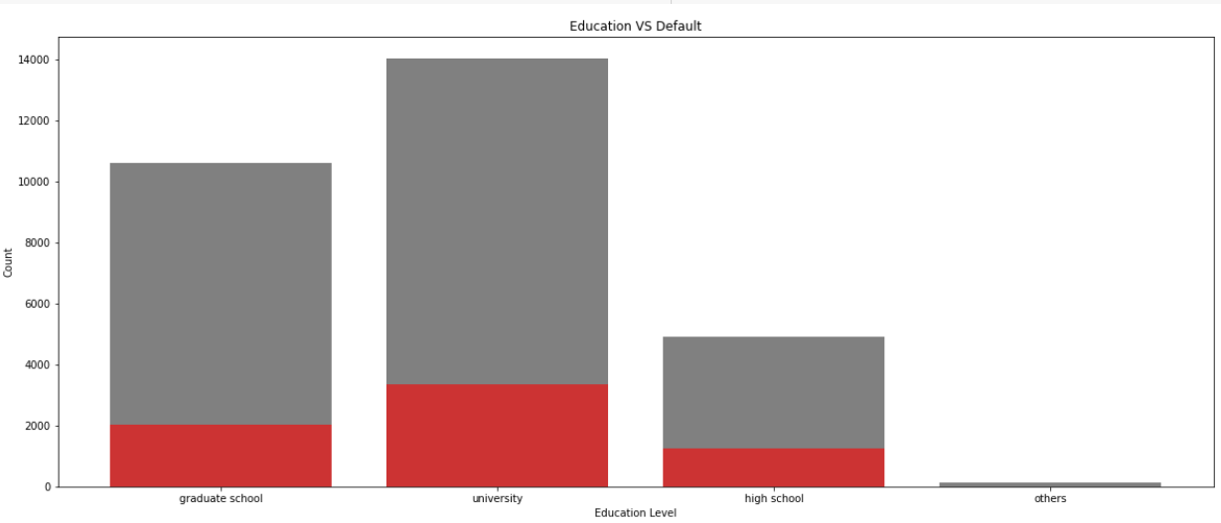
EDA
Conclusion: We can easily interpret from the above graph that most of the default section is university in education level followed by graduate schools.

Slide 9
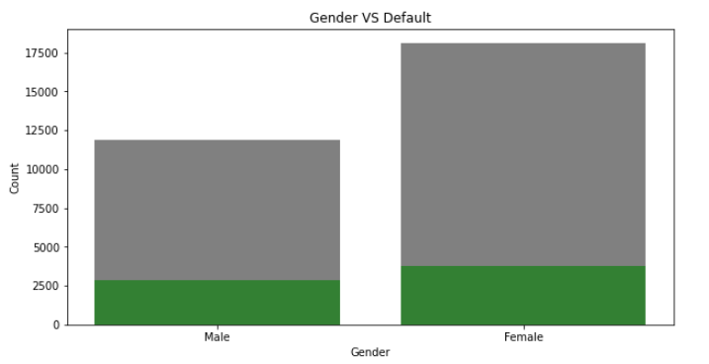
EDA (continued)
Conclusion
From the above graph we can conclude that among the gender scenario female are more default but we cannot strongly say that because the difference is very minor between male and female.

Slide 10
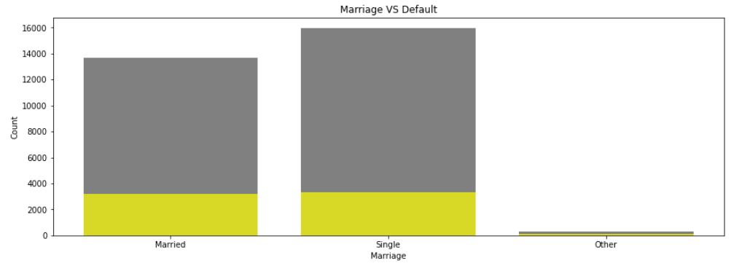
EDA (continued)
Conclusion
From the Above Bar plot we can clearly see that the married(Couple) and the singles both shows the same default result so we cannot say anything regarding marriage and singles.

Slide 11
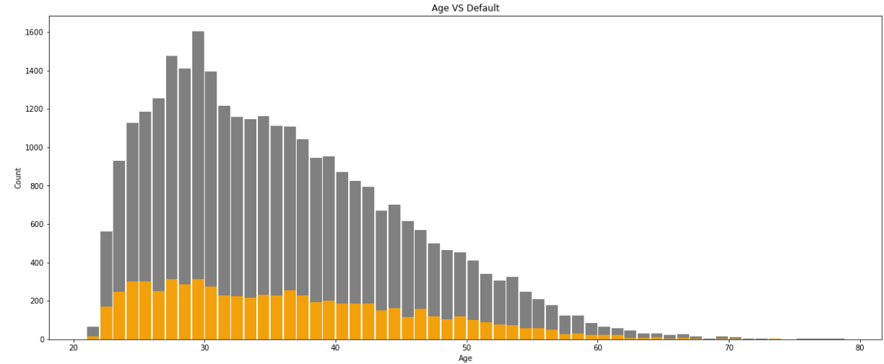
EDA (continued)
Conclusion
From the above graph we can conclude that the most default Age group is range from 23 to 38.

Slide 12
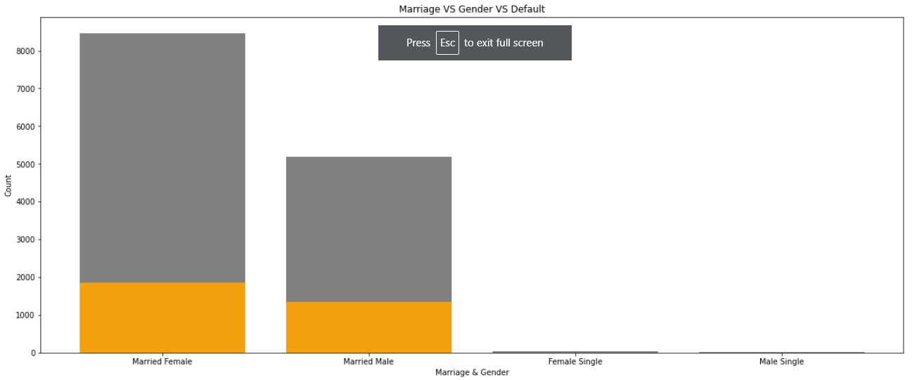
EDA
Conclusion
From the above graph we can interpret that Married Female are more default then the married male.

Slide 13
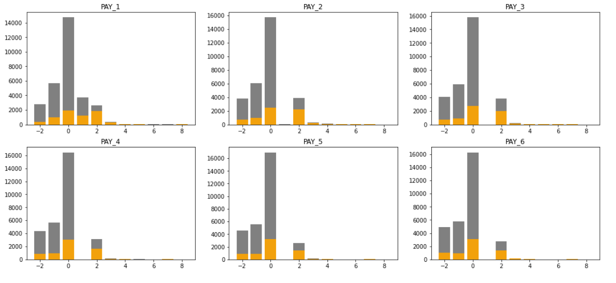
EDA (continued)
Conclusion
It seems that PAY_0 (Repayment status in September) and PAY_2 (Repayment status in August) have more discriminatory power the repayment status in other months.

Slide 14
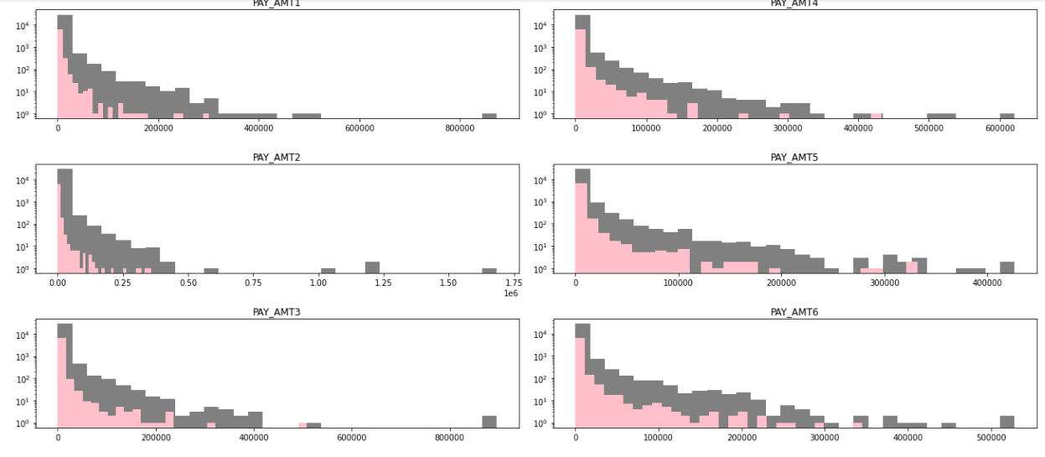
EDA (continued)
Conclusion
The above histogram shows the distribution of payment amount for each month explicitly for defaulters and non-defaulters
Because the values inputted in the PAY columns are negative and positive, the sum of these values do not show enough information of the person's credit card payment patterns. We decided to create four other features to reflect how many times they didn't use their credit card, paid their bill in full, used their revolving credit, and how many total months they were late on payments.

Slide 15
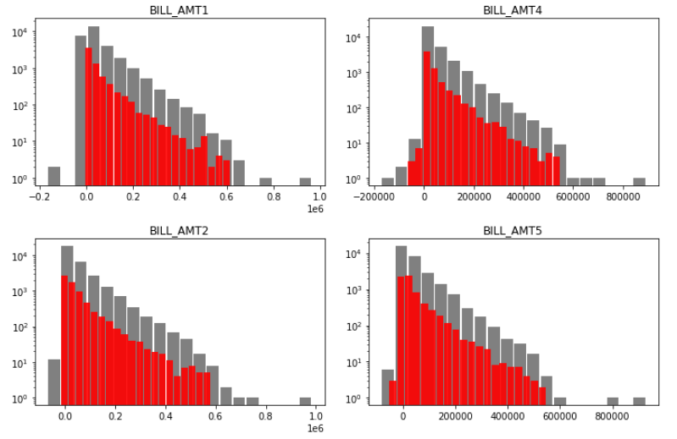
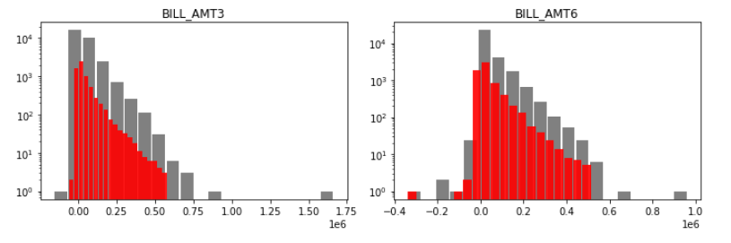
EDA (continued)
Conclusion
The above histogram shows the distribution of Bill amount generated for each month explicitly for defaulters and non-defaulters.

Slide 16
EDA Conclusion
Conclusion
There are 30,000 credit card clients.
The average value for the amount of credit card limit is 167,484 NT dollars. The standard deviation is 129,747 NT dollars, ranging from 10,000 to 1M NT dollars.
Education level is mostly graduate school and university.
Most of the clients are either married or single (less frequent the other status).
Average age is 35.5 years, with a standard deviation of 9.2.
As the value 0 for default payment means 'not default' and value 1 means 'default', the mean of 0.221 means that there are 22.1% of credit card contracts that will default next month (will verify this in the next sections of this analysis).

Slide 17
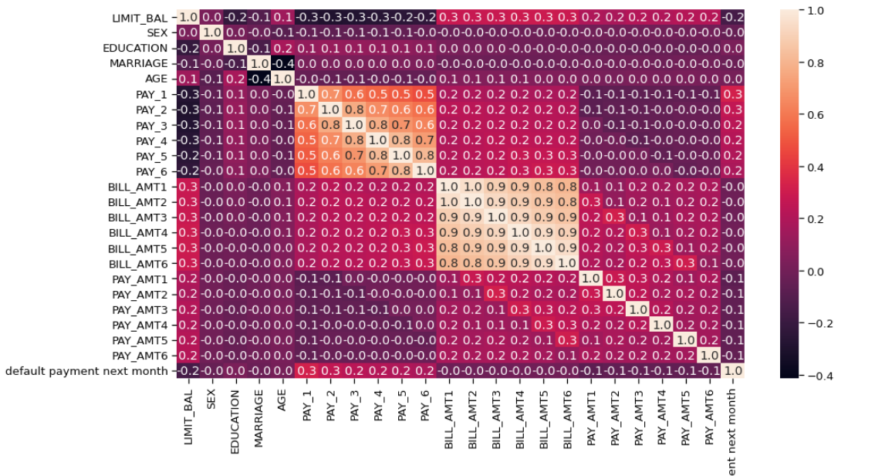
EDA (continued)
Conclusion
So it looks like the PAY_1, PAY_X variables are the strongest predictors of default, followed by the LIMIT_BAL and PAY_AMT_X variables.

Slide 18
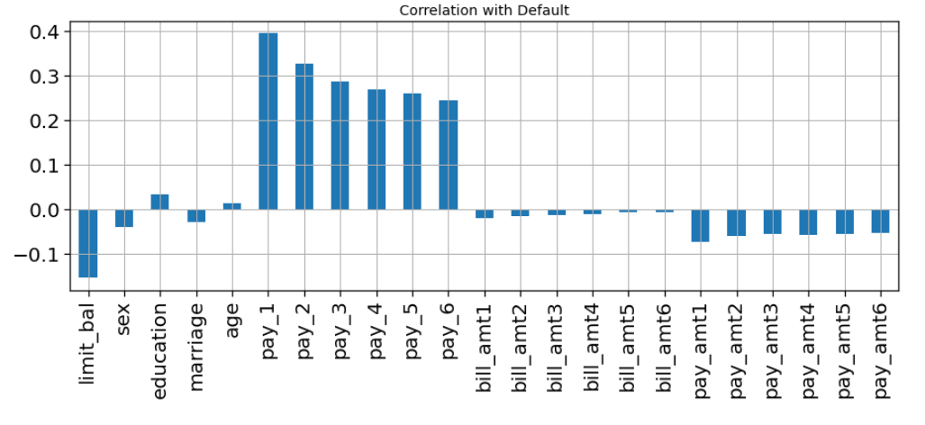
EDA (Continued)
Conclusion
It seems from the above graph is that most negatively correlated feature is LIMIT_BAL but we cannot blindly remove this feature because according to me it is very important feature for prediction. ID is unimportant and it has no role in prediction so we will remove it later.

Slide 19
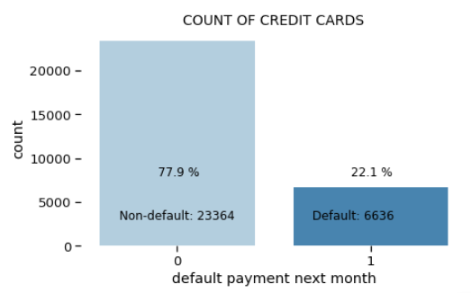
BALANCING THE UNBALANCE DATASET
From the bar plot we can interpret that the data set is highly imbalance.
The minority class “1” has only 22.1% data and the majority class has “0” has 77.9 % data.
To maintain the class imbalance problem we have used SMOTE synthetic minority oversampling technique to balance the minority class.

Slide 20

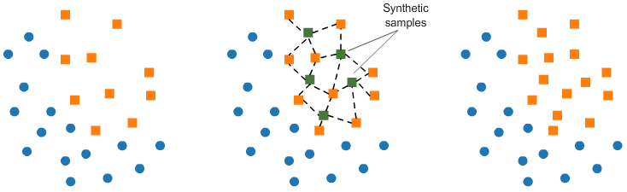
SMOTE
Synthetic Minority Oversampling Technique (SMOTE)
This technique generates synthetic data for the minority class.
SMOTE (Synthetic Minority Oversampling Technique) works by randomly picking a point from the minority class and computing the k-nearest neighbors for this point. The synthetic points are added between the chosen point and its neighbors.

Slide 21
FEATURE ENGINEERING
Feature engineering is the process of selecting, manipulating, and transforming raw
data into features that can be used in supervised learning.
Feature Engineering consists of various process :
Feature Creation (2) Transformation (3) Feature Extraction
Feature Extraction: Feature extraction is the process of extracting features from a
data set to identify useful information.
Feature Creation: Creating features involves creating new variables which will be
most helpful for our model.
Transformations: Feature transformation is simply a function that transforms features from one representation to another.

Slide 22
TRAIN – TEST SPLIT
After cleaning the data, the dataset is split into Train – Test datasets. This is done to ensure that our test dataset is completely isolated and there is no information leakage during the training process of machine learning models
DATA MODELING
In Machine Learning, we use various kinds of algorithms to allow machines to learn the relationships within the data provided and make predictions based on patterns or rules identified from the dataset.
So, logistic analysis is a machine learning technique where the model predicts the output
as a discrete numerical value.
Many models were trained, from simple parametric models like Logistic Regression to tree
based models.

Slide 23
DATA MODELING (continued)
Few of the important classification models which we have used in here are,
Logistic regression is a process of modeling the probability of a discrete outcome given an input variable. The most common logistic regression models a binary outcome; something that can take two values such as true/false, yes/no, and so on.
The decision tree classifier (Pang-Ning et al., 2006) creates the classification model by building a decision tree. Each node in the tree specifies a test on an attribute, each branch descending from that node corresponds to one of the possible values for that attribute.
K-NN classifier algorithm stores all the available data and classifies a new data point based on the similarity. This means when new data appears then it can be easily classified into a well suite category by using K- NN algorithm.

Slide 24
DATA MODELING (continued)
Naive Bayes is a probabilistic machine learning algorithm used for many classification functions and is based on the Bayes theorem. Gaussian Naive Bayes is the extension of naive Bayes. While other functions are used to estimate data distribution, Gaussian or normal distribution is the simplest to implement as you will need to calculate the mean and standard deviation for the training data.
Support Vector Machine or SVM is one of the most popular Supervised Learning algorithms, which is used for Classification as well as Regression problems. However, primarily, it is used for Classification problems in Machine Learning. The goal of the SVM algorithm is to create the best line or decision boundary that can segregate n-dimensional space into classes so that we can easily put the new data point in the correct category in the future. This best decision boundary is called a hyper plane.

Slide 25
DATA MODELING (continued)
6) "Random Forest is a classifier that contains a number of decision trees on various subsets of the given dataset and takes the average to improve the predictive accuracy of that dataset." Instead of relying on one decision tree, the random forest takes the prediction from each tree and based on the majority votes of predictions, and it predicts the final output.
7) The XGBoost or Extreme Gradient Boosting algorithm is a decision tree based machine learning algorithm which uses a process called boosting to help improve performance. Since it’s introduction, it’s become of one of the most effective machine learning algorithms and regularly produces results that outperform most other algorithms, such as logistic regression, the random forest model and regular decision trees.

Slide 26

BASE MODELS
Before fine tuned model we have used the base model to know the base accuracy of the model and then to improve the model or fine tuned it.

Slide 27
EVALUATION OF MODELS
Accuracy is one metric for evaluating classification models. Informally, accuracy is the fraction of predictions our model got right. Formally, accuracy has the following definition:
Accuracy=Number of correct predictions / Total number of predictions
For binary classification, accuracy can also be calculated in terms of positives and negatives as follows:
Accuracy=TP+TNTP+TN+FP+FN
Where TP = True Positives, TN = True Negatives, FP = False Positives, and FN = False Negatives.
The precision is the ratio tp / (tp + fp) where tp is the number of true positives and fp the number of false positives. The precision is intuitively the ability of the classifier not to label as positive a sample that is negative.
The best value is 1 and the worst value is 0.
Recall score is used to measure the model performance in terms of measuring the count of true positives in a correct manner out of all the actual positive values.
F1-score is harmonic mean of precision and recall score and is used as a metrics in the scenarios where choosing either of precision or recall score can result in compromise in terms of model giving high false positives and false negatives respectively

Slide 28
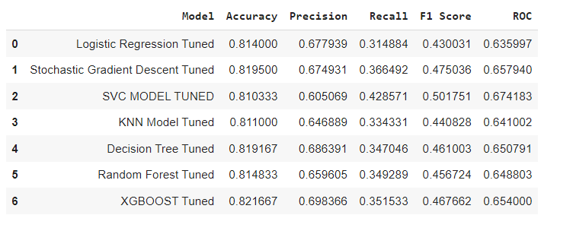
FINE TUNED MODELS
After tuning the models Xgboost shows the best result for our data set its accuracy has about to 82.1% and from the basic models the accuracy is varying from 70 to 80 %.

Slide 29
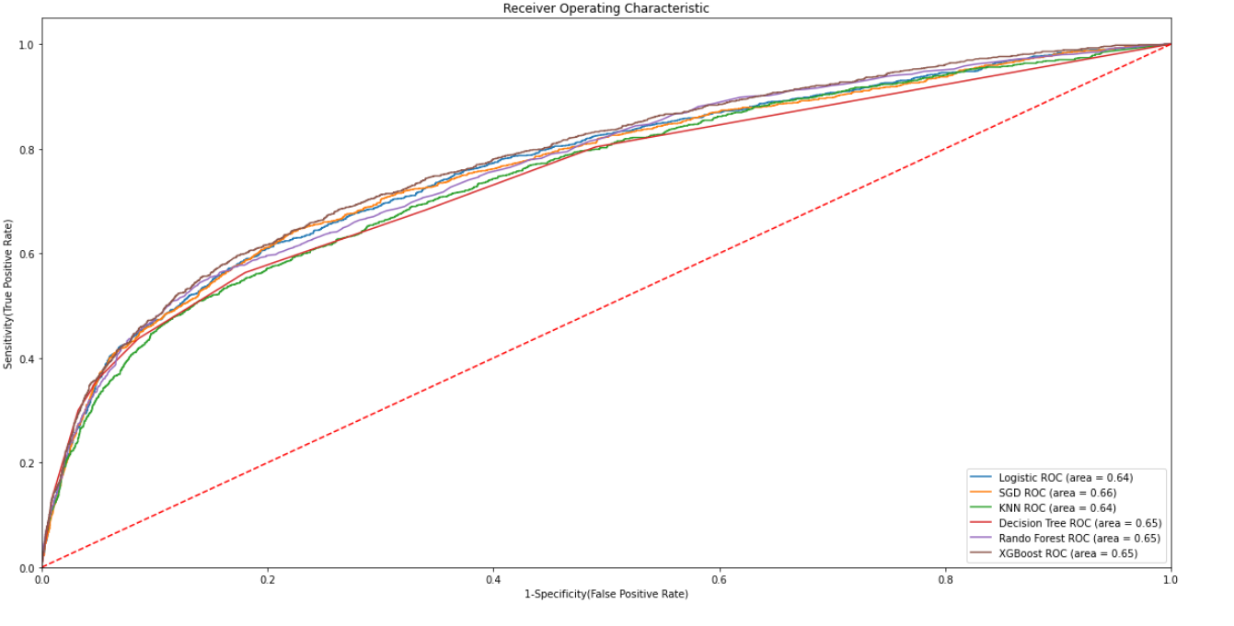
TRAIN AND TEST EVALUATION
ROC Curve
Receiver Operating Characteristic(ROC) summarizes the model’s performance by evaluating the trade offs between true positive rate (sensitivity) and false positive rate(1- specificity). For plotting ROC, it is advisable to assume p > 0.5 since we are more concerned about success rate.
ROC summarizes the predictive power for all possible values of p > 0.5. The area under curve (AUC), referred to as index of accuracy(A) or concordance index, is a perfect performance metric for ROC curve. Higher the area under curve, better the prediction power of the model.

Slide 30
CONCLUSION
1)Using a Logistic Regression classifier, we can predict with 81.4% accuracy, whether a customer is likely to default next month.
2)Using a Stochastic Gradient Descent classifier, we can predict with 81.9% accuracy, whether a customer is likely to default next month.
3)Using a Support Vector Machine classifier, we can predict with 80.81% accuracy, whether a customer is likely to default next month.
4)Using a K-Nearest Neighbour classifier, we can predict with 81.1% accuracy, whether a customer is likely to default next month.
5)Using a Decision Tree classifier, we can predict with 81.83% accuracy, whether a customer is likely to default next month.
6)Using a Random Forest classifier, we can predict with 81.4% accuracy, whether a customer is likely to default next month.
7)Using a XGBOOST classifier, we can predict with 82.16% accuracy, whether a customer is likely to default next month.
The strongest predictors of default are the PAY_X (ie the repayment status in previous months), the LIMIT_BAL & the PAY_AMTX (amount paid in previous months).
We found that using Stochastic Gradient Descent and Decision Tree are better.
Demographics: we see that being Female, More educated, Single and between 30-40years old means a customer is more likely to make payments on time.

Slide 31
Thank You

